Slide 1




Course : Machine Learning
Lecture On : Maths for NN
Instructor : Siddhesh Gunjal
EEdiditt MMaaststeerr tteexxtt ststyleyless
16-05-2021
2

Slide 2



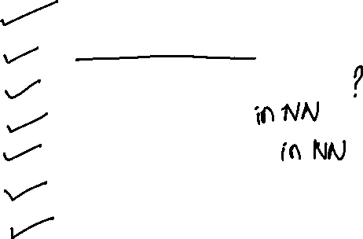
Session - Agenda
Introduction, Industry Use-cases
Weights & Bias basics
Why Activation funtion
Feed Forward
Backpropagation
Gradient Descent
Doubt Resolution
13-02-2021
3

Slide 3

In which of the following applications can we use deep learning to solve the
problem?
Protein structure prediction
Prediction of chemical reactions
Detection of exotic particles
All of these
4

Slide 4

In which of the following applications can we use deep learning to solve the
problem?
Protein structure prediction
Prediction of chemical reactions
Detection of exotic particles
All of these
We can use neural network to approximate any function so it can theoretically be used to solve any problem.
5

Slide 5
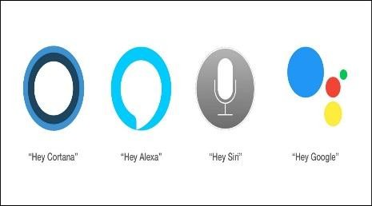





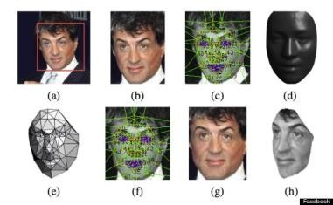



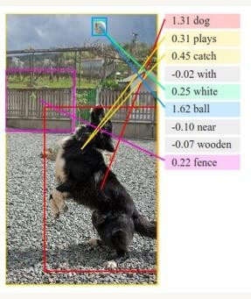





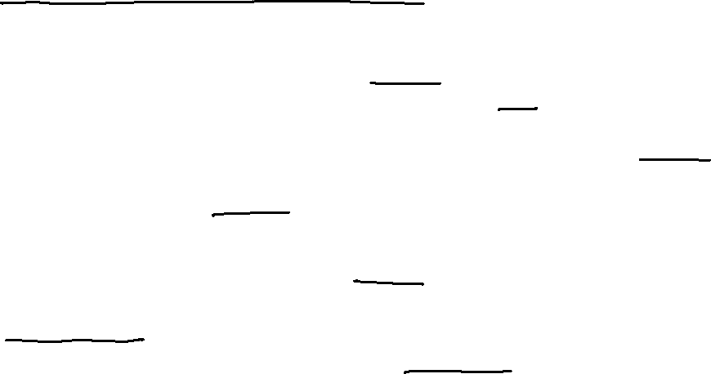
Neural Networks in Business
Voice Assistants
Recommendation Engines
The Terminator
Google
Search
Translate
maps
Facial Recognition
Self-driving cars
Image
Understanding
Email filtering
Customer Support Queries (and Chatbots)
https://www.analyticsvidhya.com/blog/2018/05/24-ultimate-data-science-projects-to-boost- your-knowledge-and-skills/
Catching Fraud in Banking
Video Surveillance
6

Slide 6
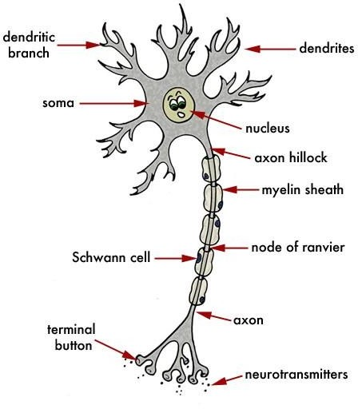
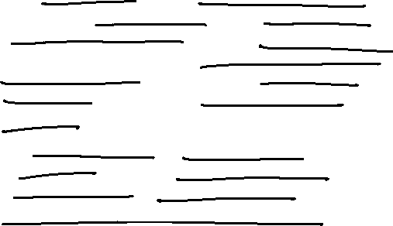
Intuition behind the Perceptron
The human brain consists of neurons or nerve cells which transmit and process the information received from our senses. Many such nerve cells are arranged together in our brain to form a network of nerves. These nerves pass electrical impulses i.e the excitation from one neuron to the other.
The dendrites receive the impulse from the terminal button. Dendrites carry the impulse to the nucleus Here , the electrical impulse is processed and then passed on to the axon
7

Slide 7
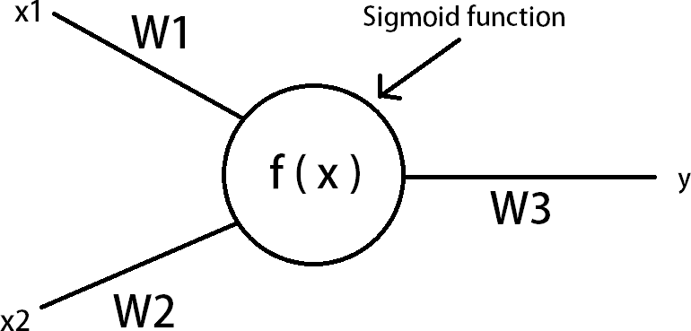
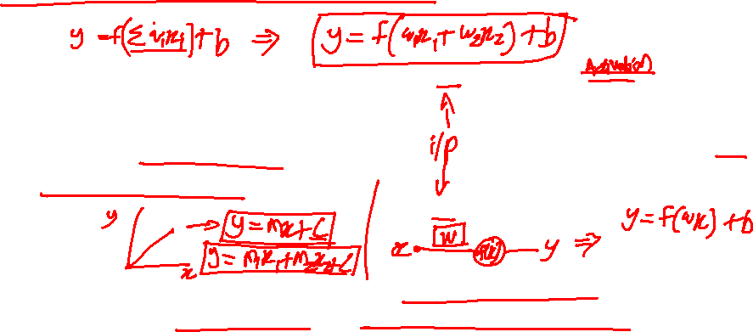
Construction of an Artificial Neuron
In this case , the neurons are created artificially on a computer . Connecting many such artificial neurons creates an artificial neural network.
The data in the network flows through each neuron by a connection. Every connection has a specific weight by which the flow of data is regulated.
8

Slide 8
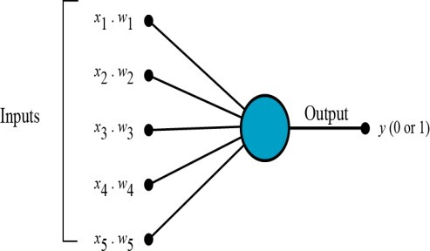
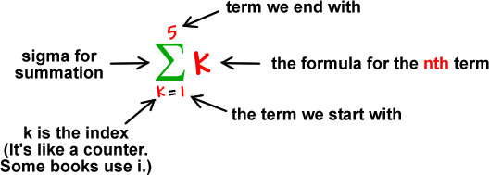
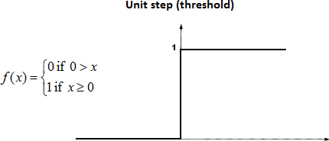
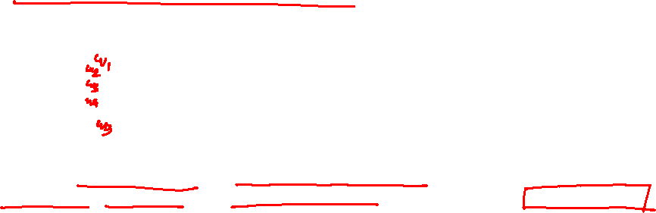
But how does it work?
The perceptron works on these simple steps
All the inputs x are multiplied with their weights w. Let’s call it k.
Add all the multiplied values and call them Weighted Sum
Apply that weighted sum to the correct Activation Function.

Slide 9
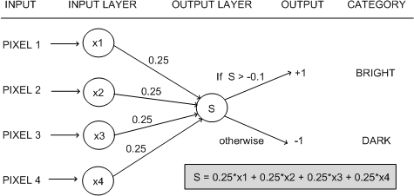
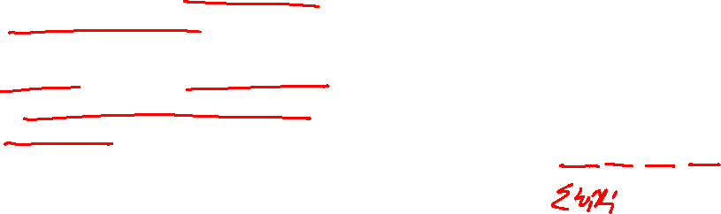
Why do we need Weights and Bias?
Weights shows the strength of
the particular node.
A bias value allows you to shift the activation function curve up or down.

Slide 10




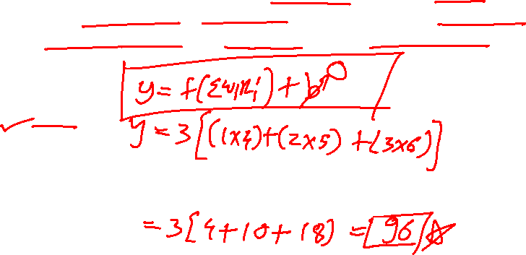
Poll 1
Assume a simple MLP model with 3 neurons and inputs= 1,2,3. The weights to the input neurons are 4,5 and 6 respectively. Assume the activation function is a linear constant value of 3. What will be the output ?
A) 32
B) 643
96
48
Practice in teams of 4 students
Industry expert mentoring to learn better
Get personalised feedback for improvements
13-02-2021
Footer
11
15

Slide 11
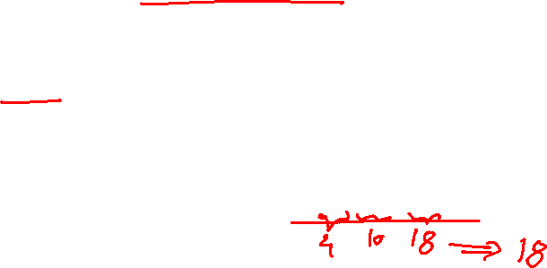
Poll 1
Assume a simple MLP model with 3 neurons and inputs= 1,2,3. The weights to the input neurons are 4,5 and 6 respectively. Assume the activation function is a linear constant value of 3. What will be the output ?
A) 32
B) 643
96
48
Practice in teams of 4 students
Get personalised feedback for improvements
The output will be calculated as 3(1*4+2 *5+6*3) =96
13-02-2021
Footer
11
16

Slide 12
Poll 2
Statement 1: It is possible to train a network well by initializing all the weights as 0
Statement 2: It is possible to train a network well by initializing biases as 0
Which of the statements given above is true?
Statement 1 is true while Statement 2 is false
Statement 2 is true while statement 1 is false
Both statements are true
Both statements are false
Practice in teams of 4 students
Industry expert mentoring to learn better
Get personalised feedback for improvements
13-02-2021
Footer
11
19

Slide 13
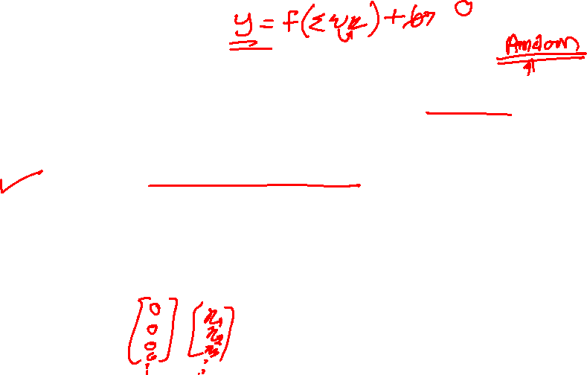
Poll 2
Statement 1: It is possible to train a network well by initializing all the weights as 0
Statement 2: It is possible to train a network well by initializing biases as 0
Which of the statements given above is true?
Statement 1 is true while Statement 2 is false
Statement 2 is true while statement 1 is false
Both statements are true
Both statements are false
Even if all the biases are zero, there is a chance that neural network may learn. On the other hand, if all the weights are zero; the neural neural network may never learn to perform the task.
Get personalised feedback for improvements
13-02-2021
Footer
11
20

Slide 14
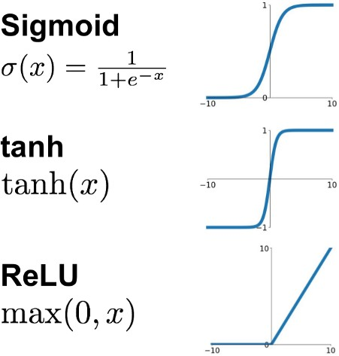
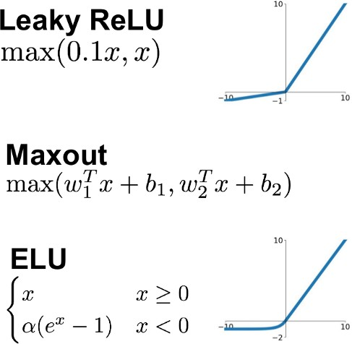
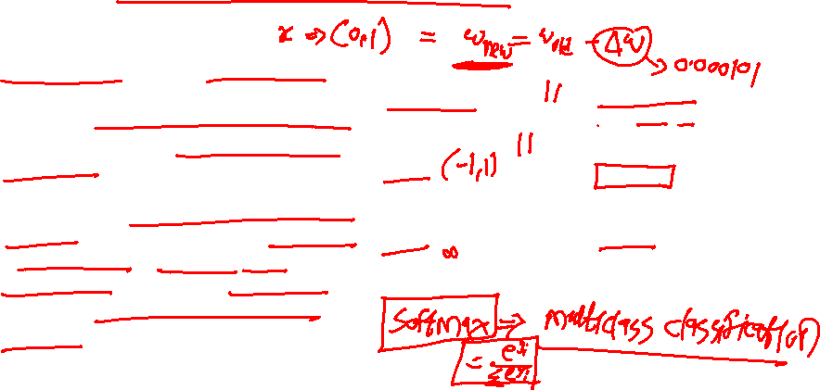
Why we use Activation functions
Activation functions are really important for a Artificial Neural Network to learn and make sense Non-linear complex functional mappings between the inputs and response variable.
They introduce non-linear properties to our Network. Their main purpose is to convert a input signal of a node in a A-NN to an output signal. That output signal now is used as a input in the next layer in the stack.
https://ai.stackexchange.com/questions/5493/what-is-the-purpose-of-an-activation-function-in-neural-networks

Slide 15


why can’t we do it without activating the input signal
A linear equation is easy to solve but they are limited in their complexity and have less power to learn complex functional mappings from data. A Neural Network without Activation function would simply be a Linear regression Model, which has limited power and does not performs good most of the times.
That is why we use Artificial Neural network techniques such as Deep learning to make sense of something complicated ,high dimensional, non-linear -big datasets, where the model has lots and lots of hidden layers in between and has a very complicated architecture which helps us to make sense and extract knowledge form such complicated big datasets.
https://towardsdatascience.com/activation-functions-neural-networks-1cbd9f8d91d6

Slide 16
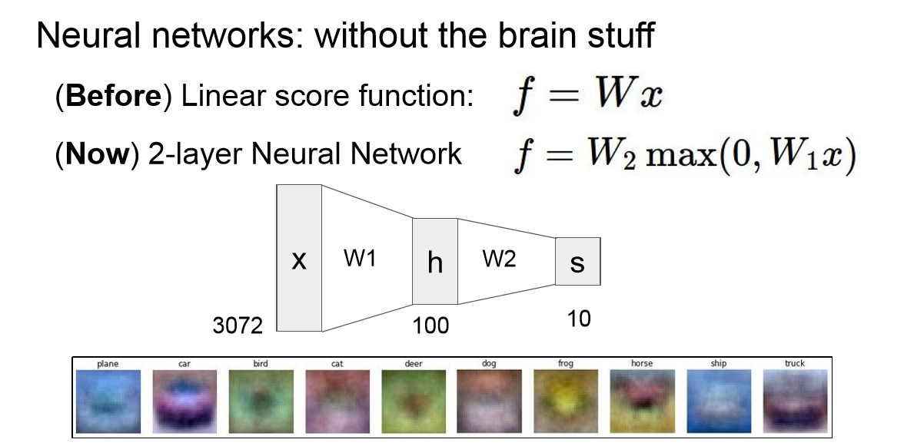
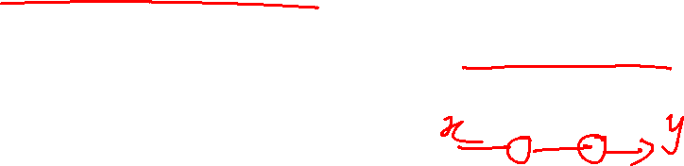
Why we use Activation functions

Slide 17
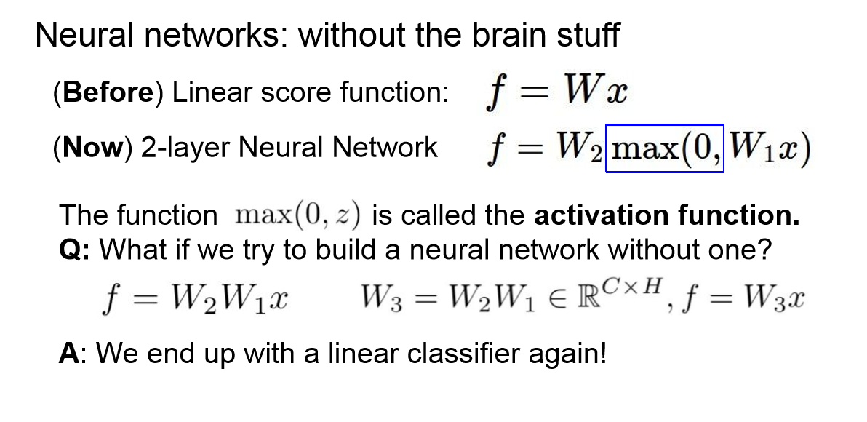
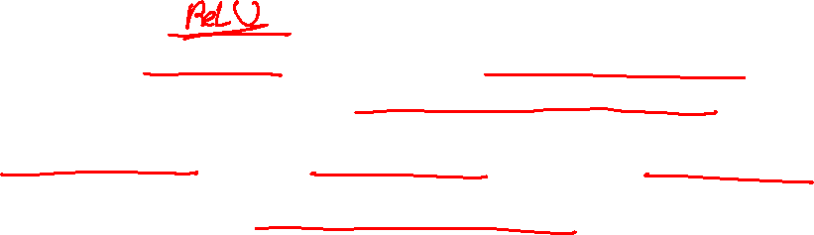
Why we use Activation functions

Slide 18
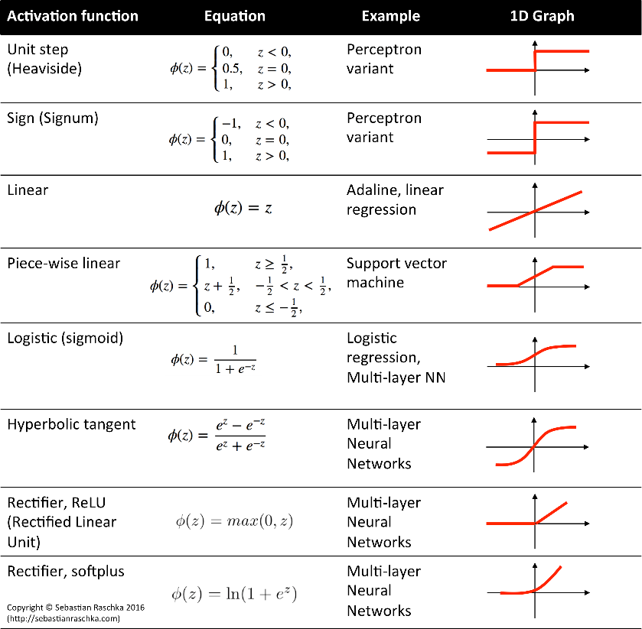
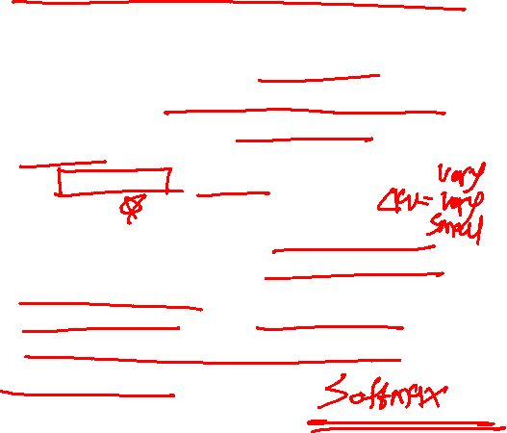
which one is better to use ?
Nowadays we should use ReLu which should only be applied to the hidden layers. And if your model suffers form dead neurons during training we should
use leaky ReLu or Maxout function.
It’s just that Sigmoid and Tanh should not be used nowadays due to the vanishing Gradient Problem which causes a lots of problems to train,degrades the accuracy and performance of a deep Neural Network Model.

Slide 19
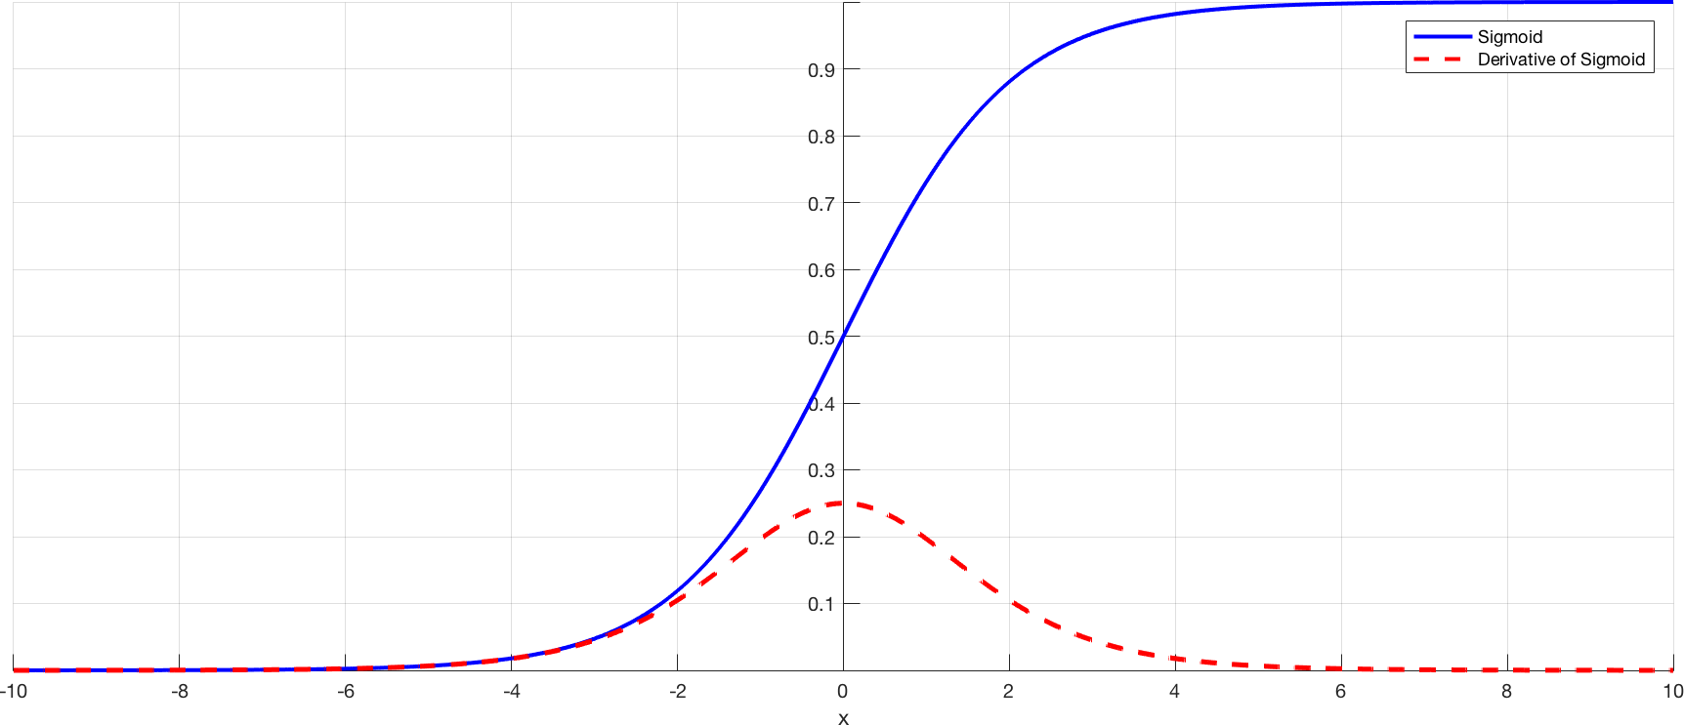
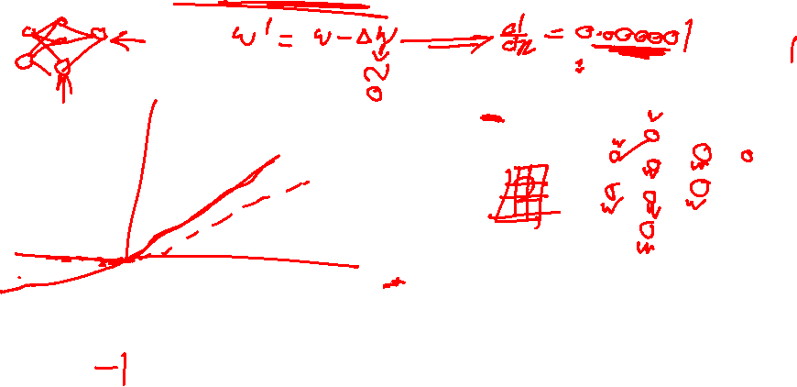
Problem of Vanishing Gradient

Slide 20
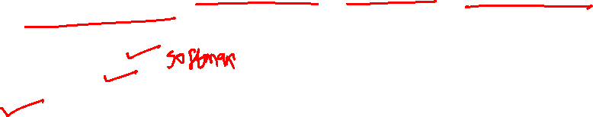
Poll 3
Which of following activation function can’t be used at output layer to
classify an image ?
sigmoid
Tanh
ReLU
D) If(x>5,1,0)
E) None of the above
Practice in teams of 4 students
Industry expert mentoring to learn better
Get personalised feedback for improvements
13-02-2021
Footer
11
25

Slide 21
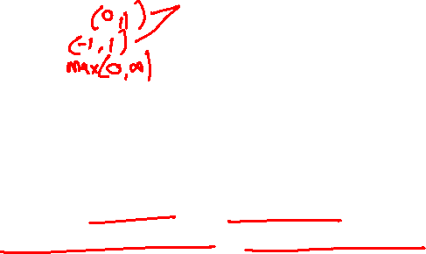
Poll 3
Which of following activation function can’t be used at output layer to
classify an image ?
sigmoid
Tanh
ReLU
D) If(x>5,1,0)
E) None of the above
Practice in teams of 4 students
Industry expert mentoring to learn better
Solution: C
ReLU gives continuous and infinite output, we
want a finite range of values. So option C is correct.
13-02-2021
Footer
11
26

Slide 22
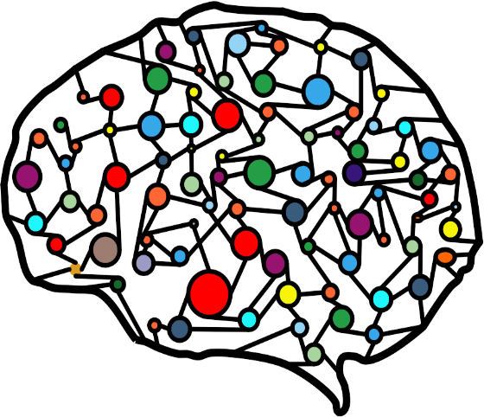

Multiple Neurons
The average human brain has 100 billion neurons
Allowing the brain to make extremely complicated
decisions
Each neuron is connected to 10,000 neurons
Which together create a complicated network of about 1000 trillion connections

Slide 23
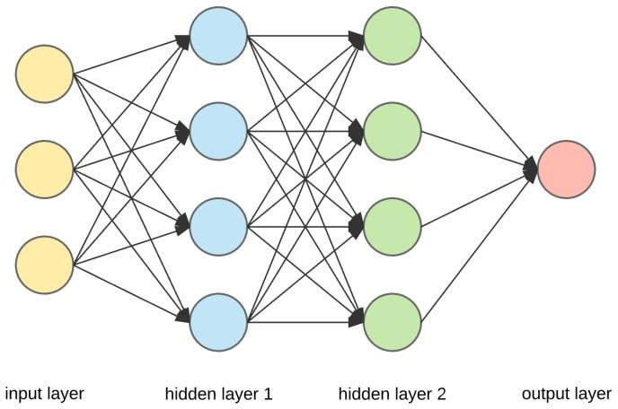
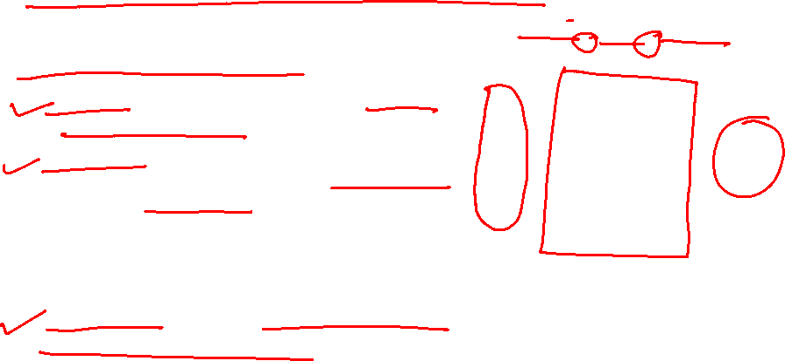
Let’s Add a Bit of Complexity Now
3 types of layers in neural network:
Input layer — It is used to pass in our input(an image, text
or any suitable type of data for NN).
Hidden Layer — These are the layers in between the input and output layers. These layers are responsible for learning the mapping between input and output. (i.e. in the dog and cat gif above, the hidden layers are the ones responsible to learn that the dog picture is linked to the name dog, and it does this through a series of matrix multiplications and mathematical transformations to learn these mappings).
Output Layer — This layer is responsible for giving us the
output of the NN given our inputs.

Slide 24
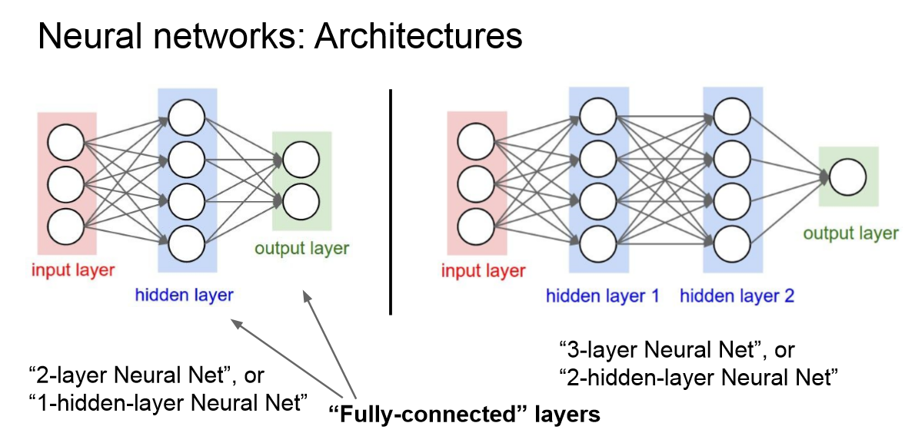
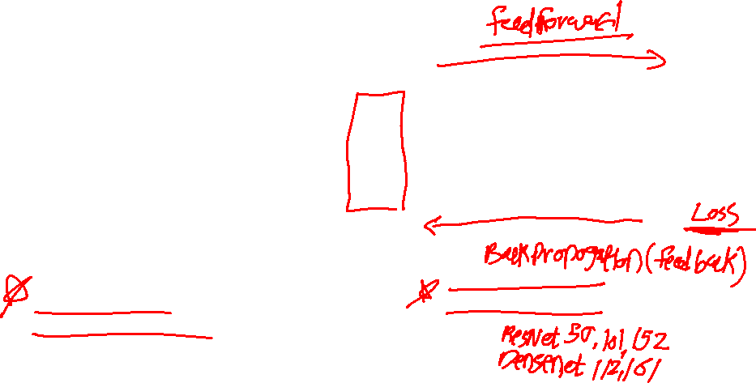
Let’s Add a Bit of Complexity Now

Slide 25
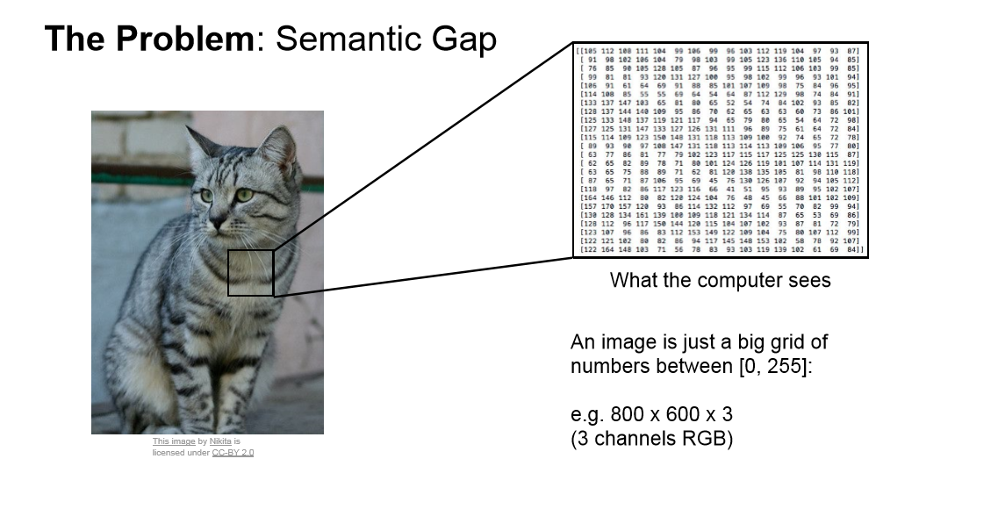
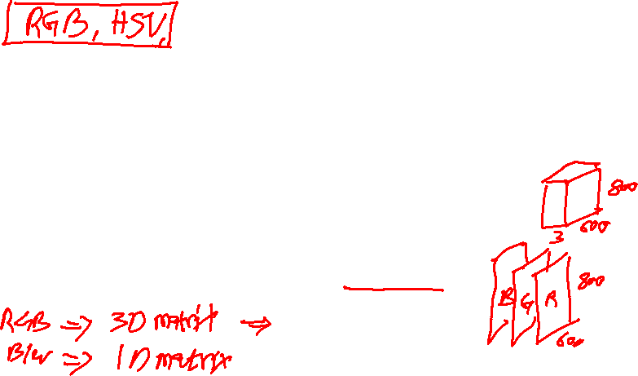
Feedforward

Slide 26
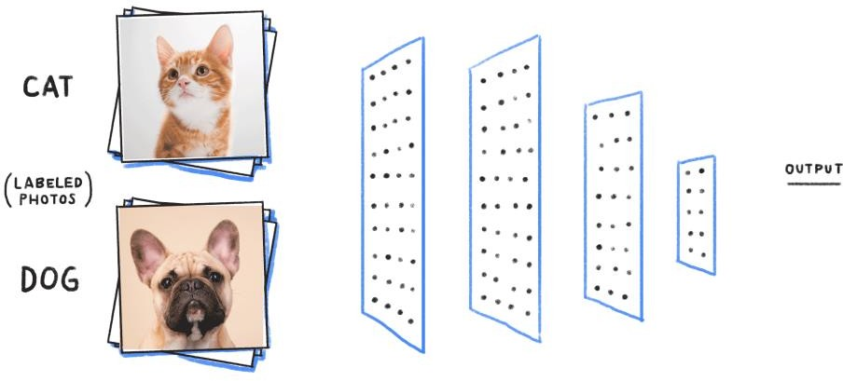
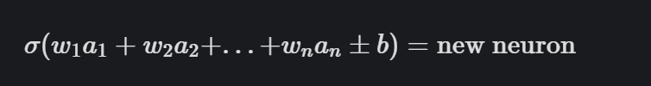
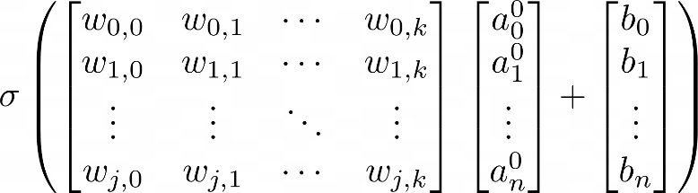

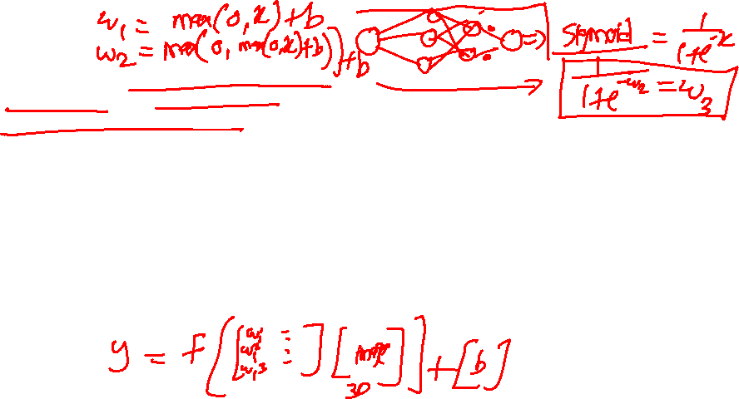
Feedforward
the output from one layer is used as input to the next layer. Such networks are called feedforward neural networks.

Slide 27
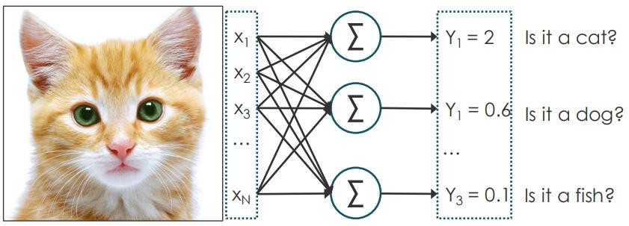
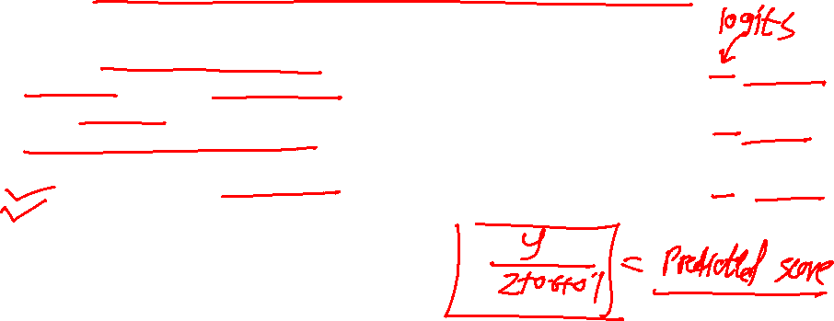
Example
To create a classifier we want the output to look like as set of probabilities
By feeding the input through the network we get a set of scores Y called “logits” but in here they cannot be used as probabilities
They are not within the range [0,1]
They do not add up to 1.

Slide 28
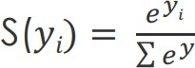
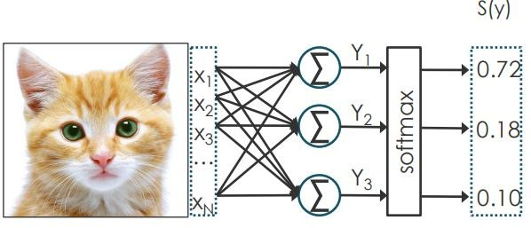
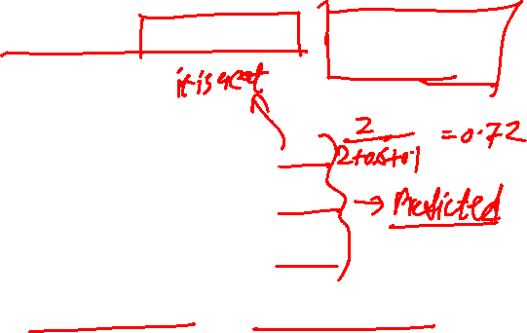
Example
To convert logits into probabilities we can use the softmax function
This guarantees all values are between [0,z] and they add up to 1.

Slide 29
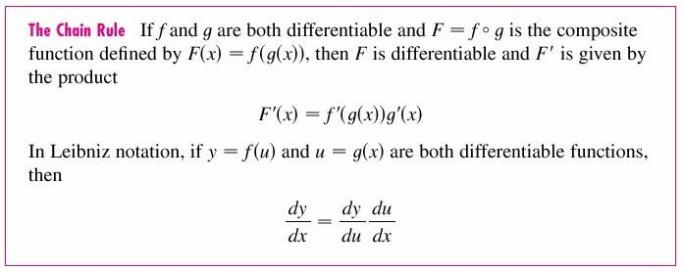
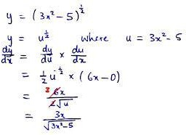
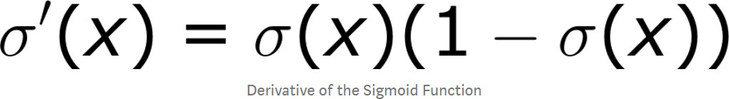
Chain Rule

Slide 30

Poll 4
The number of nodes in the input & output layers are 10 and there are 3 hidden layer having 5 nodes each what is the total number of network parameters
A) 150
B) 170
C) 220
D) It is an arbitrary value
Practice in teams of 4 students
Industry expert mentoring to learn better
Get personalised feedback for improvements
13-02-2021
Footer
11
33

Slide 31

Poll 4
The number of nodes in the input & output layers are 10 and there are 3 hidden layer having 5 nodes each what is the total number of network parameters
A) 150
B) 170
C) 220
D) It is an arbitrary value
Practice in teams of 4 students
Industry expert mentoring to learn better
Get personalised feedback for improvements
Solution: B
(50 + 25+25+50) + 20.
13-02-2021
Footer
11
34

Slide 32


Cost Function
A Cost Function/Loss Function evaluates the performance of our Machine Learning Algorithm. The Loss function computes the error for a single training example while the Cost function is the average of the loss functions for all the training examples.
The goal of any Learning Algorithm is to minimize the Cost Function.
lower error between the actual and the predicted values signifies that the algorithm has done a good job in learning.
A common measure of the discrepancy between the two values is the ”Cross-entropy”

Slide 33


Slide 34



Slide 35



Slide 36



Slide 37


Slide 38



Slide 39
Backpropagation

Slide 40


Backward Propagation

Slide 41


Backward Propagation

Slide 42

Backward Propagation

Slide 43


Backward Propagation

Slide 44

Backward Propagation

Slide 45


Backward Propagation

Slide 46

Backward Propagation

Slide 47


Backward Propagation

Slide 48


Backward Propagation

Slide 49

Backward Propagation
We know that propagation is used to calculate the gradient of the loss function with respect to the parameters.

Slide 50


Computing Gradients
L – Last Layer
L-1 – Second Last Layer
l = Layer
W = Weight Connections from one neuron to another
a = Activations (all the neurons)
Y = Output value which we want to predict
b = Bias (added value to each activation) C = Cost Function / Loss Function
Z = W * a +- b

Slide 51

Summarization
https://mlfromscratch.com/

Slide 52


Backward Propagation
dZ — Gradient of the cost with respect to
the linear output (of current layer l).

Slide 53



Training
Training refers to the task of finding the optimal combination of weights and biases to minimize the total loss
The optimization is done using the familiar gradient descent algorithm. In gradient descent, the parameter being optimized is iterated in the direction of reducing cost according to the following rule

Slide 54



Gradient Descent
Starting at the top of the mountain, we take our first step downhill in the direction specified by the negative gradient. Next we recalculate the negative gradient (passing in the coordinates of our new point) and take another step in the direction it specifies. We continue this process iteratively until we get to the bottom of our graph, or to a point where we can no longer move downhill–a local minimum.
Gradient descent is an optimization algorithm used to minimize some function by iteratively moving in the direction of steepest descent as defined by the negative of the gradient

Slide 55



Gradient Descent
In practice, we might never exactly reach the minima, but we keep oscillating in a flat region in close vicinity of the minima. As we oscillate our this region, the loss is almost the minimum we can achieve, and doesn't change much as we just keep bouncing around the actual minimum.
Often, we stop our iterations when the loss values haven't improved in a pre-decided number, say, 10, or 20 iterations. When such a thing happens, we say our training has converged, or convergence has taken place.
22-05-2022

Slide 56


Example
GIF'ed from 3blue1brown video

Slide 57


Example
GIF'ed from 3blue1brown video

Slide 58


Gradient Desent – Way to Find Weights
43

Slide 59


#LifeKoKaroLift
Thank You!
21
13-02-2021

